Slide 1
Physical and Data link Layers
Chapter 4

Slide 2
Analog and Digital Data
Data usually refers to raw data, or unprocessed data.
Data that hasn’t been analyzed or processed in any manner.
Analog Data: The term analog data refers to information that is continuous value;
For example, an analog clock, sound
Digital data: refers to information that has discrete states.
For example, a digital clock 8:05
E.g. Computer take 0 s and 1 s
A signal is an electric current or electromagnetic field used to transport data from one place to another.
Like the data they represent, signals can be either analog or digital.
An analog signal has infinitely many levels of intensity over a period of time.
A digital signal, on the other hand, can have only a limited number of defined values(1,0)

Slide 3
Cont…
The curve representing the analog signal passes through an infinite number of points.
The vertical lines of the digital signal, however, demonstrate the sudden jump that the signal makes from value to value.

Slide 4
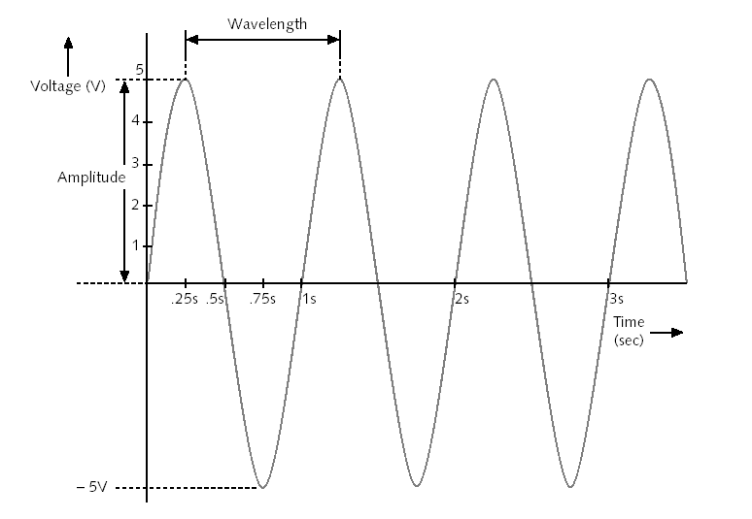
Characteristics of Signals
Amplitude – A measure of waveform strength at a given point in time
Amplitude at 0.25 sec = 5 volts
Amplitude at 0.5 sec = 0
Amplitude at 0.75 sec = -5 volts
Peak Amplitude
The peak amplitude of a signal is the absolute value of its highest intensity, proportional to the energy it carries.
For electric signals, peak amplitude is normally measured in volts.

Slide 5
Cont…
Period and Frequency
Period refers to the amount of time, in seconds, a signal needs to complete 1 cycle.
Frequency is the number of complete cycles per second in alternating current direction.
Period is formally expressed in seconds.
Frequency is formally expressed in Hertz (Hz), which is cycle per second.

Slide 6
Cont…
Phase
The term phase describes the position of the waveform relative to time 0.
If we think of the wave as something that can be shifted backward or forward along the time axis, phase describes the amount of that shift.
A phase shift of 360° corresponds to a shift of a complete period
A phase shift of 180° corresponds to a shift of one-half of a period and
A phase shift of 90° corresponds to a shift of one-quarter of a period.

Slide 7
Cont…
Wavelength
The wavelength is the distance a simple signal can travel in one period.
Wavelength is inversely proportional to frequency - high frequency implies short wavelength
The wavelength is normally measured in micrometers (microns) instead of meters.

Slide 8
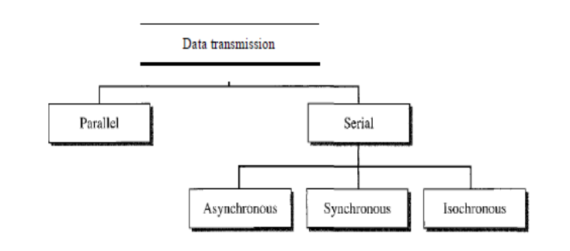
Data Transmission
The transmission of binary data across a link can be accomplished in either parallel or serial mode.
In parallel mode, multiple bits are sent with each clock tick.
In serial mode, 1 bit is sent with each clock tick.

Slide 9
Parallel Transmission
The mechanism for parallel transmission is a conceptually simple one: Use n wires to send n bits at one time.

Slide 10
Serial Transmission
In serial transmission one bit follows another, so we need only one communication channel rather than n to transmit data between two communicating devices.
The advantage of serial over parallel transmission is , serial transmission reduces the cost
Serial transmission occurs in one of three ways:
Asynchronous,
Synchronous, and
Isochronous.

Slide 11
Asynchronous Transmission
Information is received and translated by agreed upon patterns.
To alert the receiver to the arrival of a new group, therefore, an extra bit is added to the beginning of each byte. This bit, usually a 0, is called the start bit.
To let the receiver know that the byte is finished, 1 or more additional bits are appended to the end of the byte. These bits, usually 1 s, are called stop bits.
In addition, the transmission of each byte may then be followed by a gap of varying duration.
The start and stop bits and the gap alert the receiver to the beginning and end of each byte and allow it to synchronize with the data stream.
This mechanism is called asynchronous because, at the byte level, the sender and receiver do not have to be synchronized.

Slide 12
Synchronous Transmission
In synchronous transmission, the bit stream is combined into longer "frames," which may contain multiple bytes.
Each byte, however, is introduced onto the transmission link without a gap between it and the next one.
It is left to the receiver to separate the bit stream into bytes for decoding purposes.
In other words, data are transmitted as an unbroken string of 1s and 0s, and the receiver separates that string into the bytes, or characters.
The advantage of synchronous transmission is speed.
Byte synchronization is accomplished in the data link layer.

Slide 13
Isochronous
In real-time audio and video, in which uneven delays between frames are not acceptable, synchronous transmission fails.
For example, TV images are broadcast at the rate of 30 images per second; they must be viewed at the same rate.
If each image is sent by using one or more frames, there should be no delays between frames.
For this type of application, synchronization between characters is not enough; the entire stream of bits must be synchronized.
The isochronous transmission guarantees that the data arrive at a fixed rate.

Slide 14
Transmission Mode
As we discuses in chapter one , Data communications are the exchange of data between two devices via some form of transmission medium such as a wire cable/wireless.
Irrespective of whether we are using digital or analogue transmission, all data communications can be divided into three types Transmission Mode:
Simplex – one direction only
Half-duplex – both directions, but only one direction at a time
Full-duplex –Both direction at the same time

Slide 15
Transmission Impairment
Signals travel through transmission media, which are not perfect. The imperfection causes signal impairment.
This means that the signal at the beginning of the medium is not the same as the signal at the end of the medium. What is sent is not what is received.
Three causes of impairment are attenuation, distortion, and noise.

Slide 16
Cont…
Attenuation
Attenuation means a loss of energy.
When a signal, travels through a medium, it loses some of its energy in overcoming the resistance of the medium.
That is why a wire carrying electric signals gets warm, if not hot, after a while. Some of the electrical energy in the signal is converted to heat.
To compensate for this loss, amplifiers are used to amplify the signal.
Attenuation is measured in terms of Decibels.
The decibel (dB) measures the relative strengths of two signals or one signal at two different points.
Note that the decibel is negative if a signal is attenuated and positive if a signal is amplified.

Slide 17
Cont…
Distortion:
Distortion means that the signal changes its form or shape.
Distortion can occur in a signal made of different frequencies.
Each signal component has its own propagation speed through a medium and, therefore, its own delay in arriving at the final destination.
Differences in delay may create a difference in phase if the delay is not exactly the same as the period duration.
In other words, signal components at the receiver have phases different from what they had at the sender. The shape of the composite signal is therefore not the same.

Slide 18
Cont…
Noise
Noise is another cause of impairment. Several types of noise, such as Thermal noise, Induced noise, Crosstalk, and Impulse noise, may corrupt the signal.
Thermal noise is the random motion of electrons in a wire which creates an extra signal not originally sent by the transmitter.
Induced noise comes from sources such as motors and electrical device. These devices act as a sending antenna, and the transmission medium acts as the receiving antenna.
Crosstalk is called electromagnetic interference (EMI). It can occur in microcircuits within computers and audio equipment as well as within network circuits.
It is the effect of one wire on the other. One wire acts as a sending antenna and the other as the receiving antenna.
Impulse noise is a spike (a signal with high energy in a very short time) that comes from power lines, lightning, and so on.

Slide 19
Conversion
Information must be transformed into signals before it can be transported across the communication media.
Data stored in the computer is in the form of 0’s and 1’s.
To be carried from one place to the other, data is usually converted to digital signals, This is called “Digital-to-Digital Conversion” or “Encoding digital data into digital signals” .
Sometimes we need to convert an analog signal to the digital signal,, This is called “Analog-to-Digital Conversion” or “Digitizing an Analog Signal” .
We might want to send a digital signal coming out of computer through a medium designed for analog signals, For example, To send data from one place to the other using a Telephone line, This is called “Digital-to-Analog Conversion” or “Modulating a digital Signal” .

Slide 20
Cont…
Digital-to-Digital Conversion
Digital-to-Digital conversion/encoding is the representation of digital information by digital signal.
Non return to zero (NRZ)
NRZ codes share the property that voltage level is constant during a bit interval.
High level voltage = bit 1 and Low level voltage = bit 0 or viceversal
For example, a voltage level of zero could represent a 0 digit, and a positive voltage could represent a 1 digit.

Slide 21
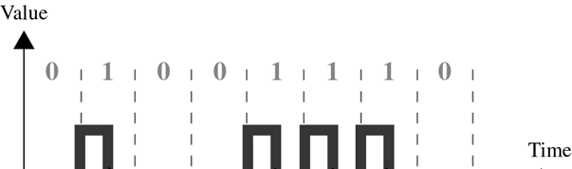
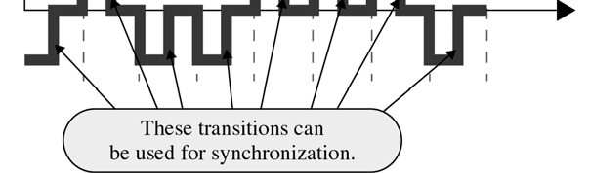
Cont…
Return to Zero (RZ)
RZ encoding which uses 3 values : positive, negative and Zero
signal changes not b/w bits but during each bit
+ve voltage means 1 and a –ve voltage means 0,
A 1 bit is represented by positive to zero transition and a 0 bit is represented by negative To zero transition
The only problem with RZ encoding is that it requires two signal changes To encode one bit and therefore occupies more BANDWIDTH

Slide 22
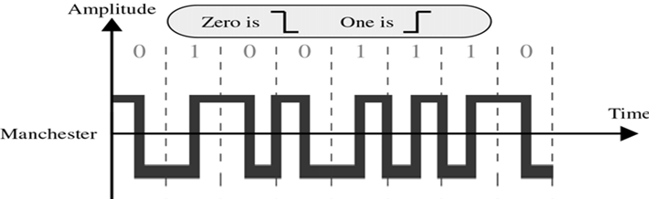
Cont…
Manchester
Signal changes at the middle of bit interval but does not stop at zero, Instead it continues to the opposite pole.
Negative-to-Positive Transition= 1
Positive-to-Negative Transition = 0
By using a single transition for a dual purpose, Manchester achieves the same level of synchronization as RZ but with only two levels of amplitude.

Slide 23
Digital-To-Analog Conversion
Digital-to-analog conversion is the process of changing one of the characteristics of an analog signal based on the information in digital data.
Figure 5.1 shows the relationship between the digital information, the digital-to-analog modulating process, and the resultant analog signal.

Slide 24
Cont…
A sine wave is defined by three characteristics: amplitude, frequency, and phase.
When we vary anyone of these characteristics, we create a different version of that wave. So, by changing one characteristic of a simple electric signal, we can use it to represent digital data.
There are three mechanisms for modulating digital data into an analog signal:
Amplitude shift keying (ASK)
Frequency shift keying (FSK)
Phase shift keying (PSK).

Slide 25
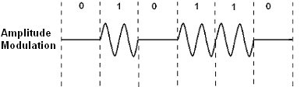
Cont…
Amplitude Shift Keying (ASK)
In amplitude shift keying, the amplitude of the carrier signal is varied to create signal elements.
Both frequency and phase remain constant while the amplitude changes.
Amplitude shift keying (ASK), the amplitude, or height of the wave, is modulated to represent the 1s and 0s of the signal.

Slide 26
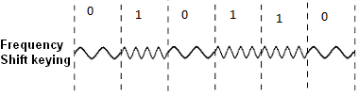
Cont…
Frequency Shift Keying (FSK)
In frequency shift keying, the frequency of the carrier signal is varied to represent data.
The frequency of the modulated signal is constant for the duration of one signal element, but changes for the next signal element if the data element changes.
In frequency shift keying (FSK), the frequency is modulated, with two different frequency values representing the two binary values.
Both peak amplitude and phase remain constant for all signal elements.

Slide 27

Cont…
Phase Shift Keying (PSK)
In phase shift keying, the phase of the carrier is varied to represent two or more different signal elements.
Both peak amplitude and frequency remain constant as the phase changes.
In phase shift keying (PSK), it is the phase that is modulated: to transmit a binary 0 the phase should remain the same as the previous bit transmitted, for a binary 1 the phase should change by 180o (i.e. the opposite phase).
Today, PSK is more common than ASK or FSK.

Slide 28
Cont…
Generally, the word modulation refers to the conversion of digital data to analogue signals. Demodulation refers to the opposite process.
Since computers store all information in digital form, and telephone lines always use analogue transmission, it follows that the computer’s data must be modulated before transmission and demodulated upon reception.
The device that performs these tasks is called a modulator/demodulator, or modem.

Slide 29
Multiplexing
Whenever the bandwidth of a medium linking two devices is greater than the bandwidth needs of the devices, the link can be shared.
Multiplexing is the set of techniques that allows the simultaneous transmission of multiple signals across a single data link.
In a multiplexed system, n lines share the bandwidth of one link.
Figure 6.1 shows the basic format of a multiplexed system.

Slide 30
Cont…
The lines on the left direct their transmission streams to a multiplexer (MUX), which combines them into a single stream (many-to-one).
At the receiving end, that stream is fed into a demultiplexer (DEMUX), which separates the stream back into its component transmissions (one-to-many) and directs them to their corresponding lines.
One link can have many (n) channels.
There are three basic multiplexing techniques:
Frequency-division multiplexing,
Wavelength-division multiplexing, and
Time-division multiplexing.
The first two are techniques designed for analog signals, the third, for digital signals.

Slide 31
FLOW AND ERROR CONTROL
Data communication requires at least two devices working together, one to send and the other to receive.
The most important responsibilities of the data link layer are
Flow control and
Error control.
Collectively, these functions are known as data link control.
Flow Control: Flow control coordinates the amount of data that can be sent before receiving an acknowledgment and is one of the most important duties of the data link layer.
Error Control: Error control is both error detection and error correction.
It allows the receiver to inform the sender of any frames lost or damaged in transmission and coordinates the retransmission of those frames by the sender.

Slide 32
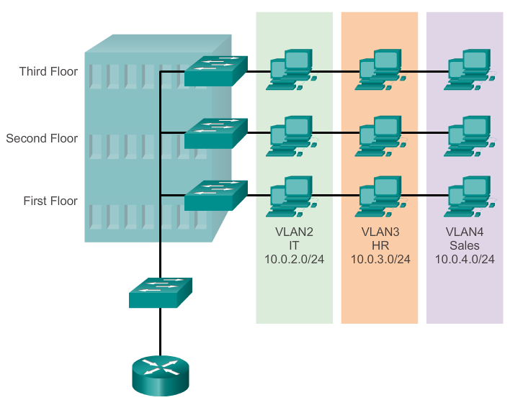
VLANs
VLAN (virtual LAN) is a logical partition of a network
The partitioning of the layer 2 network takes inside a layer 2 device, usually a switch.
Administrators assign membership in a VLAN either statically or dynamically.
Static VLAN membership requires an administrator to manually assign each switch port to a specific VLAN.
Example, port fa0/3 may be assigned to VLAN 20.
Any device that plugs into port fa0/3 automatically becomes a member of VLAN 20.

Slide 33
Cont.…
Dynamic VLAN membership requires a VLAN management policy server (VMPS).
The VMPS contains a database that maps MAC addresses to VLAN assignments.
When a device plugs into a switch port, the VMPS searches the database for a match of the MAC address and temporarily assigns that port to the appropriate VLAN.

Slide 34
Configuring VLAN
Whether VLANs are created statically or dynamically, the maximum number of VLANs depends on the type of switch and the IOS.
By default, VLAN1 is the management VLAN.
Management VLAN
A management VLAN is any VLAN configured to access the management capabilities of a switch.
When a VLAN is created, it is assigned a number and a name.
The VLAN number is any number from the range available on the switch, except for VLAN1.
Set the following commands to create a VLAN using global configuration mode:
Switch(config)#vlan vlan_number
Switch(config-vlan)#name vlan_name
Switch(config-vlan)#exit

Slide 35
Cont.….
Assign ports to be members of the VLAN.
By default, all ports are initially members of VLAN1.
Assign ports one at a time or as a range.
Switch(config)#interface fa#/#
Switch(config-if)#switchport access vlan vlan_number
Switch(config-if)# exit
Assign by range
Switch(config)#interface range fa#/start_of_range - end_of_range
Switch(config-if)#switchport access vlan vlan_number
Switch(config-if)#exit

Slide 36
Cont.….
The following commands are used to verify and maintain VLANs:
show vlan
Displays a detailed list of all of the VLAN numbers and names currently active on the switch, along with the ports associated with each one
show vlan id id_number
Displays information pertaining to a specific VLAN, based on ID number
Show vlan name vlan_name
Displays information pertaining to a specific VLAN, based on name
To delete a VLAN:
Switch(config)#no vlan vlan_number
To disassociate a port from a specific VLAN:
Switch(config)#interface fa#/#
Switch(config-if)#no switchport access vlan vlan_number

Slide 37
Trunk port
A VLAN has three major functions:
Limits the size of broadcast domains
Improves network performance
Provides a level of security
To take full advantage of the benefits of VLANs, they are extended across multiple switches.
Switch ports can be configured for two different roles.
Access port
A trunk port.

Slide 38
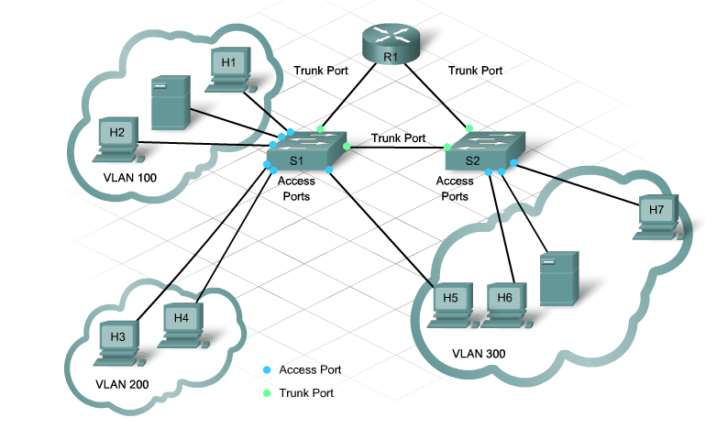
Cont.….
Access Port
An access port belongs to only one VLAN.
Typically, single devices such as PCs or servers connect to this type of port.
Access ports also carry traffic that comes from only the VLAN assigned to the port.
Trunk Port
A trunk port is a point-to-point link between the switch and another networking device.
Trunks carry the traffic of multiple VLANs over a single link and allow VLANs to reach across an entire network.

Slide 39
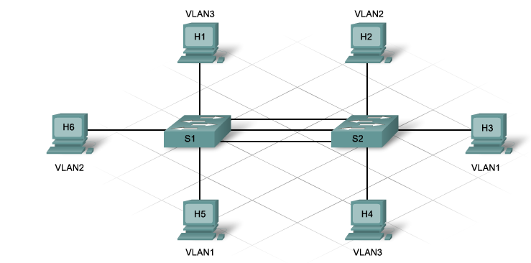
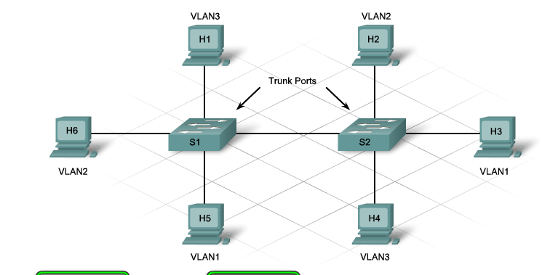
Cont.…..
Without trunk ports, each VLAN requires a separate connection between switches.
For example, an enterprise with 100 VLANs requires 100 connecting links.
Trunk links provide a solution to this problem by transporting traffic from multiple VLANs on the same link.
When multiple VLANs travel on the same link, they need VLAN identification.
A trunk port supports frame tagging. Frame tagging adds VLAN information to the frame.
Cisco developed a proprietary frame tagging protocol called Inter-Switch Link (ISL).
Switch ports are access ports by default.
To configure a switch port as a trunk port, use the following commands:
Switch(config)#interface fa #/#
Switch(config-if)#switchport mode trunk

